Slide 1
Optimized File Transfer with Integrated Parallel Data compression
Yicheng Yang

Slide 2



Introduction
Sender
Low bandwidth?
Large file?
Receiver
Compress
Divide
Deliver
Combine
Decompress
Project ideal outcome:
The implementation can speedup efficiency of file transfer in low bandwidth/large file condition.

Slide 3
Parallelism Hypothesis
Parallel Data Compression
Parallel File Transfer
This is main issue in my project.
Data parallelism: a large file can be divided into partitions for multiple-thread execution.
Design a customed protocol based on TCP (or UDP) that enables sending the file in parallel.
1. Data parallelism: the compressed file can be still divided into pages and assigned to multiple sender threads.
2. Task parallelism: all receiver threads can listen to the same port.

Slide 4
Parallel Data Compression

Slide 5
Compression algorithm
Gzip / Pigz
My Algorithm
Better suited for general-purpose compression, especially for larger and more complex data sets.
LZ77
Huffman coding
Better suited for files with predictable patterns and high redundancy. (text, GIF images…)
PLZW (Parallel-Lempel-Ziv-Welch)
Huffman coding (Parallel version)

Slide 6
LZW (Lempel-Ziv-Welch)
Dictionary
A | 65
B | 66
AB | 256
BA | 257
…
Hello | 24678
Encodes recurring patterns as single dictionary indices.
Better suited for file with high redundancy.
Builds the dictionary dynamically as it processes the input, no need for dictionary storage.
HelloworldABAB
24678 389 256 256

Slide 7
PLZW challenge
C: Can the dictionary be shared in all the thread?
S: No, if shared,
Pros: Better compression effect
Cons: 1. There will be serious race condition in dictionary update.
2. This will produce data dependency during decompressing process.
3. Unordered map in C++ is not thread-safe.
C: How to decompress the file that is encoded using multiple dictionary?
S: Separate compressed file with a marker and treat the partition independently. When decompressing, use marker to divide the compressed file in a same way.

Slide 8
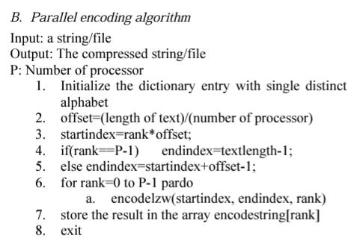
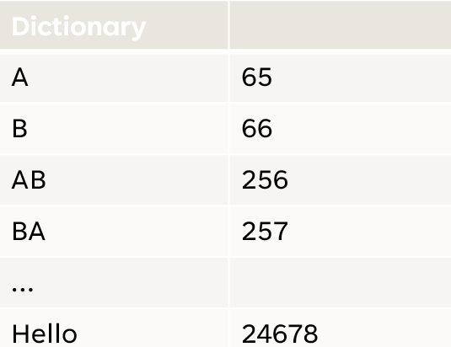
PLZW (Parallel-Lempel-Ziv-Welch)
Compression Process:
LZW
marker
marker

Slide 9
Huffman Coding
Huffman coding works by assigning shorter codes to frequently occurring characters and longer codes to less frequent characters, ensuring the overall encoded data is as compact as possible.
Code (after LZW) | Frequency | Code (after
24678 | 1 | 000
256 | 2 | 001
65 | 6 | 01
66 | 10 | 1
HelloworldABAB
24678 389 256 256
000 001 1 1

Slide 10
Parallel-Huffman Challenge
Identify parallel part and serial part:
Parallel part: Frequency calculation, it is data parallelism. Divide the file into partition, count the frequency and add up.
Serial part: Build Huffman tree. Strong data dependency, can not be executed paralleled.

Slide 11
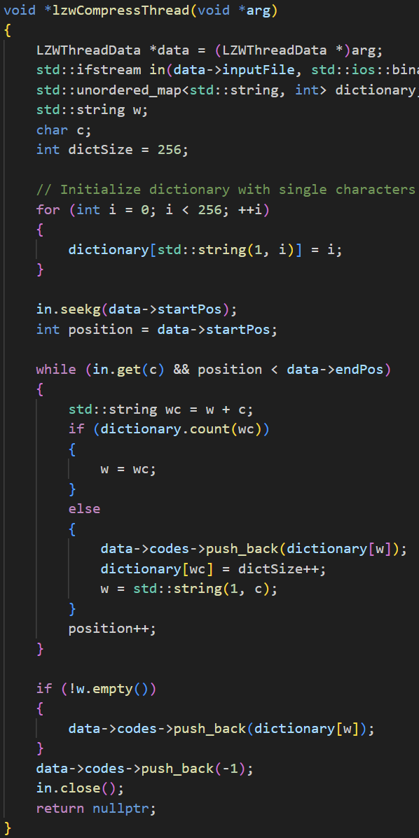
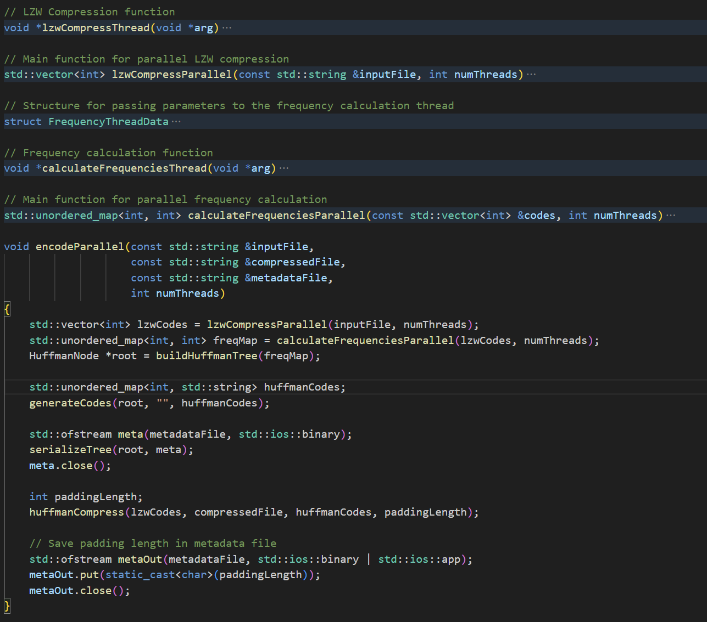
implementation
Language: C++
Include: pthread

Slide 12
Parallel File Transfer

Slide 13
Data division
page
packet
Can be send Parallelled
seq
Compressed file
seq
seq
seq

Slide 14

Packet Transfer
Sender
Receiver
Use socket to establish connection.
When receiver get the packet, it will send back an ACK with sequence number.
If no ACK returns, the thread will wait for timeout and then resend.
seq
Sender threads
Receiver threads
seq

Slide 15
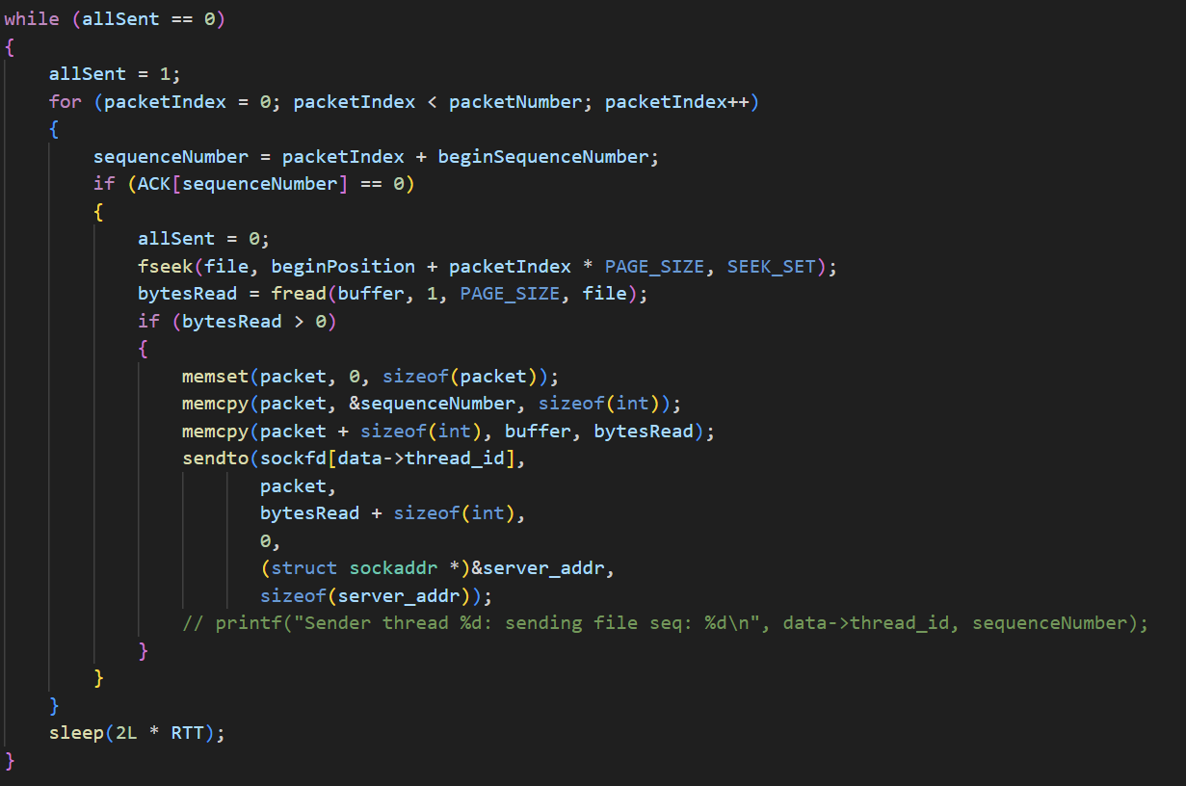
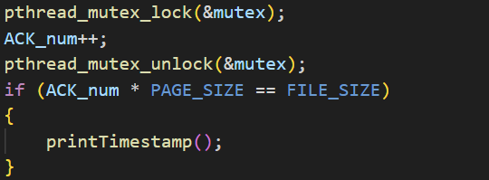
Challenge
C: Shared resources Allocation in the threads.
S:
Socket and file describe pointer is not thread-safe -> Store them in private.
Multiple I/O operations on a single file ->
Multiple file pointer utilized to avoid overwriting
Lock utilized when operation occurs on the entire file

Slide 16
Test & Result

Slide 17
Test on data compression
Environment: Linux (Laptop)
Dataset:
English Bible : 4496KB
Pattern image: 282KB
Random generated file: 64MB
Parameter:
Number of thread: 1, 2, 4, 8, 16, 32, 64

Slide 18
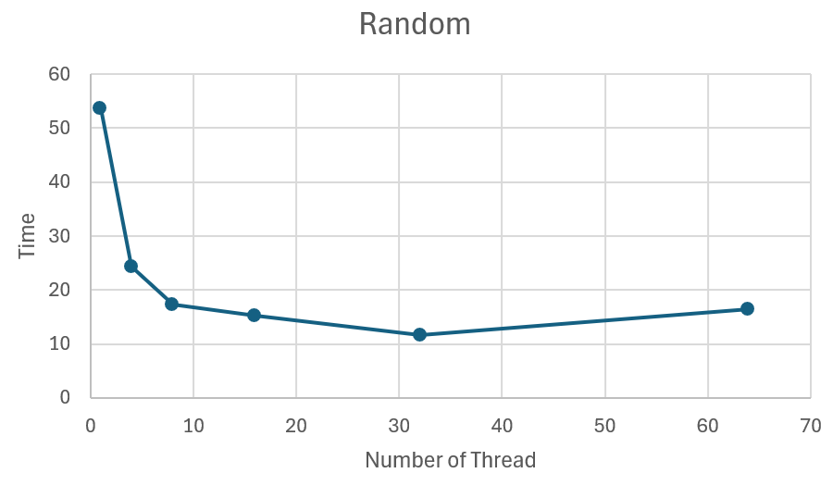
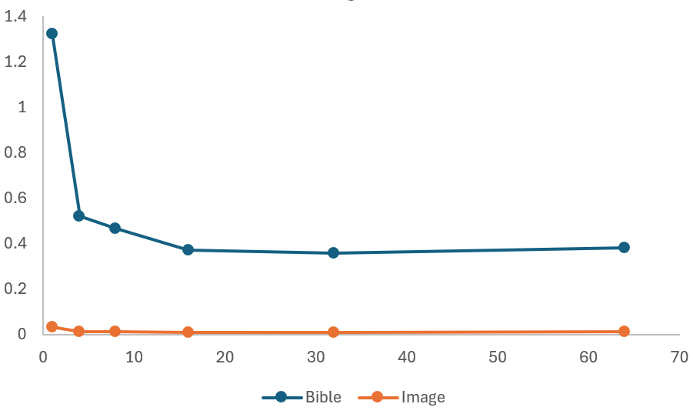
Execution time

Slide 19
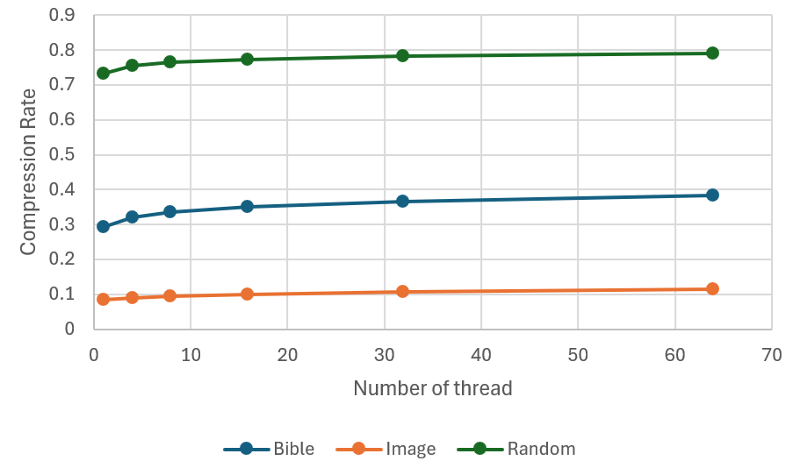
Compression rate
Compression rate = size of compressed file / size of original file
As the number of thread increases, the compression rate increases. This is due to private dictionary in each thread. The same piece of string can be encoded differently in different thread.

Slide 20
Test on File Transfer
Environment: Linux (AWS)
Two host in a same subnet, one for sender, one for receiver.
Network:
Use command
sudo tc qdisc add dev eth0 root tbf rate 50mbit latency 1ms burst 90155
To limit the bandwidth between two host
Dataset:
English Bible : 4496KB
Multiple Copies of bible: 64MB
Multiple Copies of image pattern: 1GB
Parameter:
Number of thread: 32 threads for data compression, 16 threads for file transfer.

Slide 21
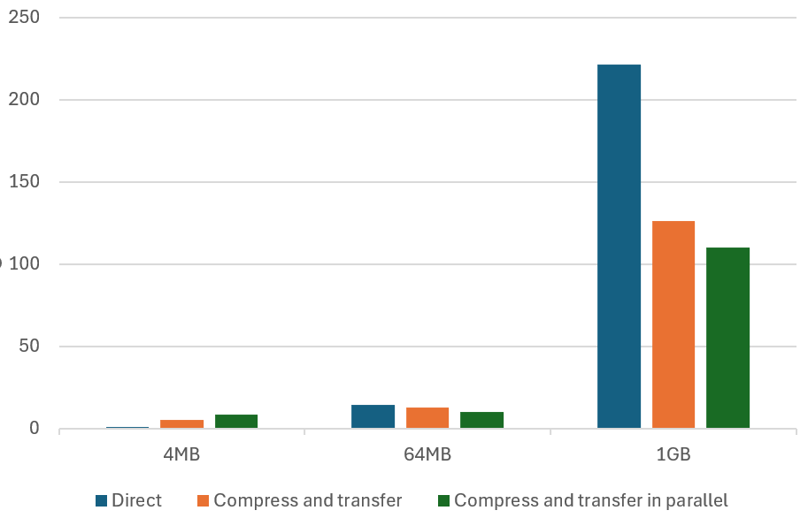
Test on File Transfer
File | Direct transfer | Compress and transfer | Compress and transfer in parallel
Bible (4496KB) | 1.010562 sec | 5.210365 sec | 8.163251 sec
Bible (64MB) | 14.245025 sec | 12.543218 sec | 10.217863 sec
Image (1GB) | 221.125476 sec | 126.325486 sec | 110.254632 sec

Slide 22
Reference
Mishra, Manas Kumar et al. “Parallel Lempel-Ziv-Welch ( PLZW ) Technique for Data Compression.” (2012).
Vitter, Jeffrey Scott. "Design and analysis of dynamic Huffman codes." Journal of the ACM (JACM) 34.4 (1987): 825-845.

Slide 23
Q & A

